Slide 1
Georgia O’Keefe’s Flowers

Slide 2
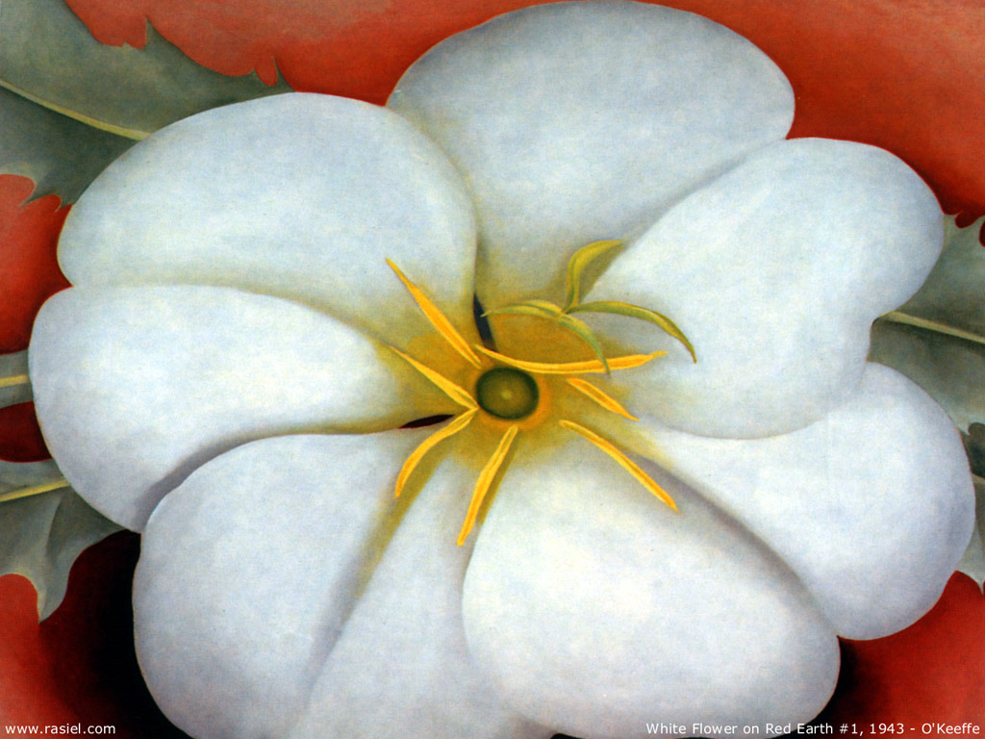
Draw the outline of the flower and it’s petals with pencil. Make sure to use the entire space of the paper.

Slide 3
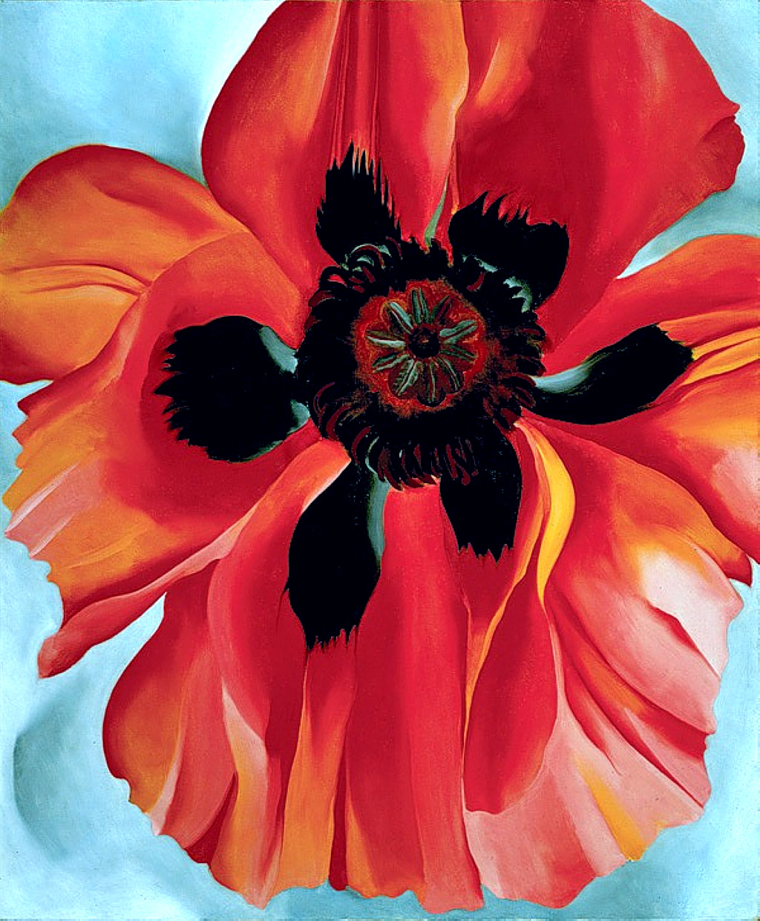
Next, outline the sketch, tracing over the pencil marks with permanent marker.

Slide 4
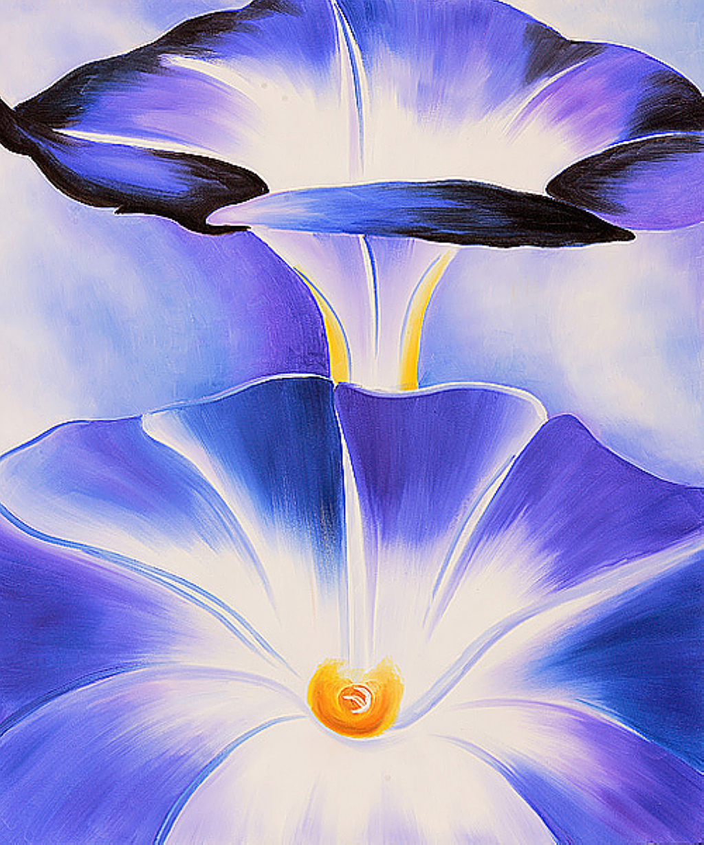
Begin painting with the lightest color and then add shadows slowly going darker and darker.
If any area is to stay white, leave it completely blank.

Slide 5
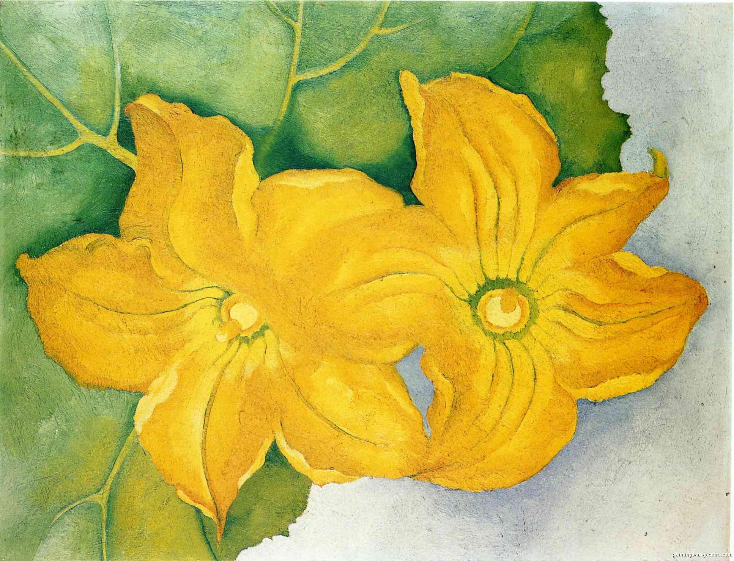
Fill in the background with a light color – it should not distract from the flower.

