Slide 1
Overlapping Lines
Father Day Gift
ITWA IC
May 23, 2013

Slide 2
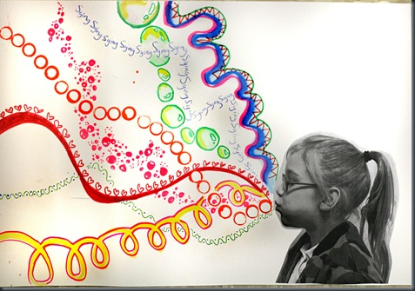

Slide 5
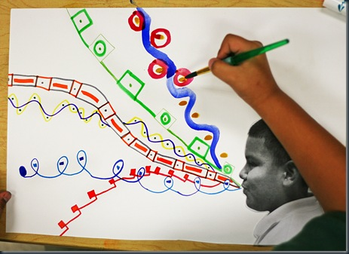

Slide 6
