Slide 1
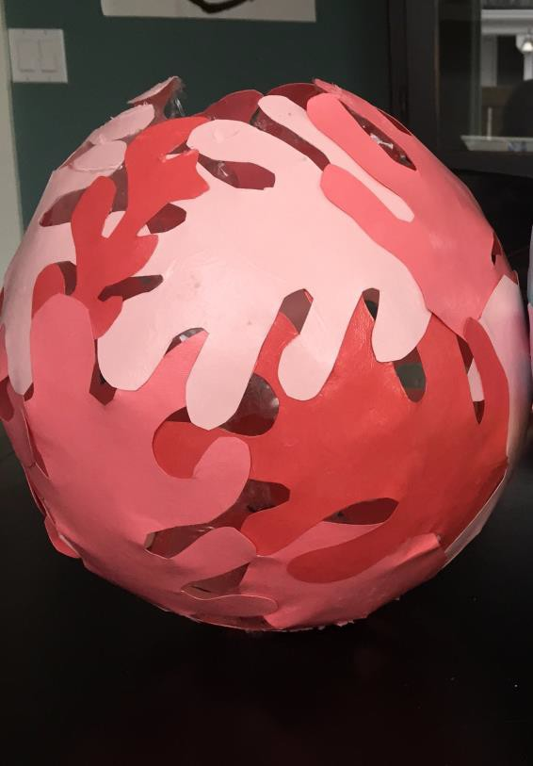
Henri Matisse
Matisse Egg Project

Slide 2
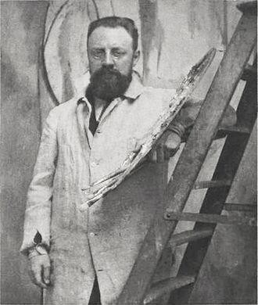
Henri-Emile-Benoit Matisse
1869-1954
◆ Henri Matisse was a French artist who was born in 1869 in northern France to a prosperous grain merchant family. At the age of 18, Henri moved to Paris to study law and he began working as a court administrator.
◆ When he was 20, Henri suffered from an appendicitis. His mother gave him a paint set to keep him busy during his long recovery. It was during this time that Henri discovered his true calling and, to his father’s disappointment, decided to become an artist instead of a lawyer.
◆ Matisse and Pablo Picasso are regarded as leading figures in the modern art movement. He was known as a draughtsman, printmaker and sculptor but he is most known for his paintings. Here are a few examples:

Slide 3
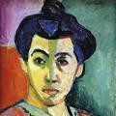
Madame Matisse (1905)

Slide 4
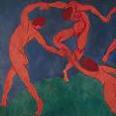
The Dance (1910)

Slide 5
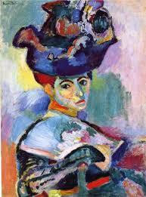
Woman with the Hat (1905)

Slide 6
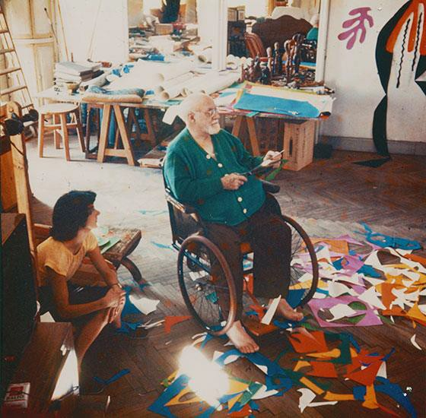
The Cut Out Years
◆ Well into his successful art career, Henri suffered from abdominal cancer in 1941 and underwent surgery that left him bound to a bed or wheel chair.
Because he was in a sitting position, painting and sculpture became too challenging so he focused on cut outs. His assistants would paint large sheets of paper and he would cut the sheets of paper into different shapes and sizes. He would then arrange them into collage or decoupage compositions. Some were regular size but others could be as large as a room.
◆ For those who do not know, decoupage is a form of artwork created by gluing paper cutouts onto a shape. The artwork we will be doing today is a form of decoupage.
◆ Here are a few examples of Henri’s cut out art.

Slide 7
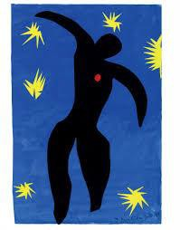
Icarus (1946)

Slide 8
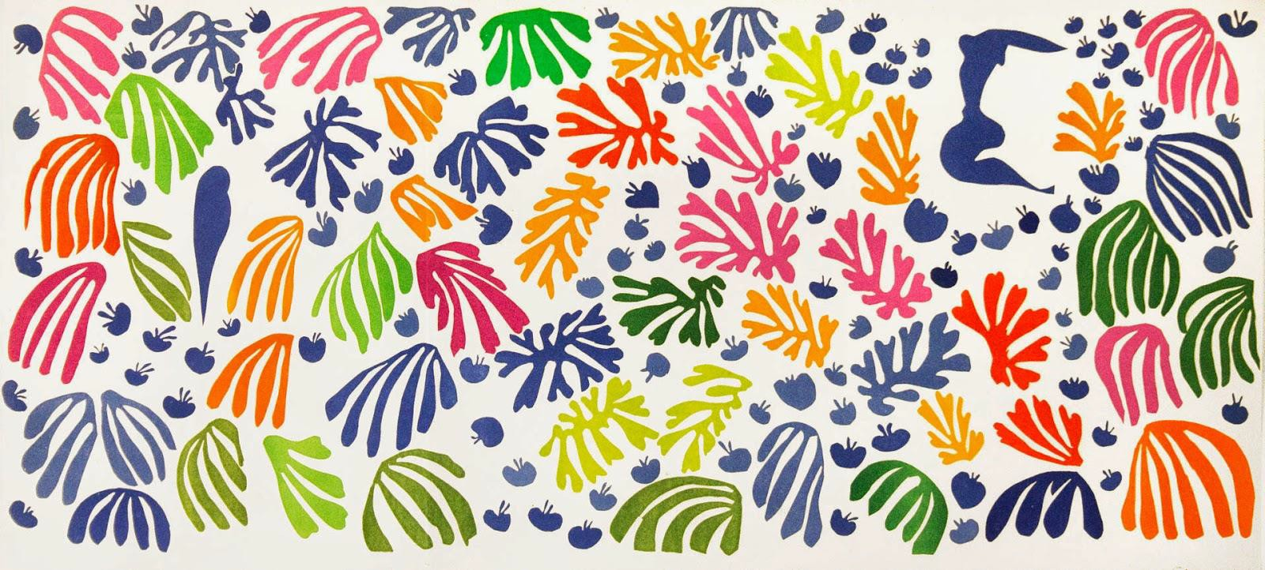
The Parakeet and the Mermaid (1952)

Slide 9
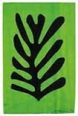
Black Leaf on Green Background (1952)

Slide 10
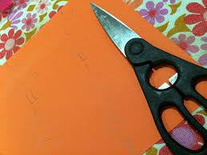
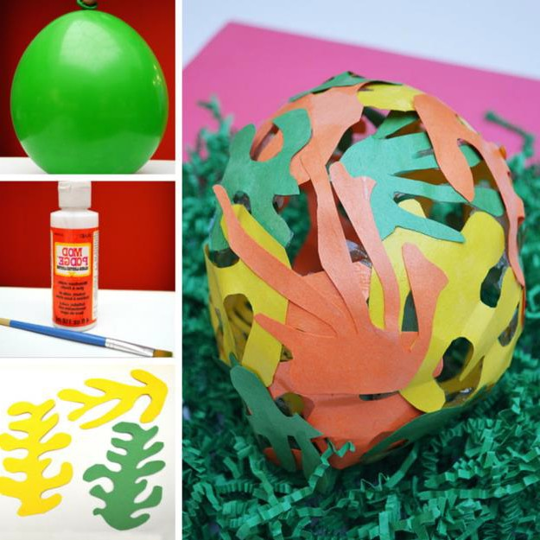
Matisse Egg
Supplies you will need:
◆ Every child should receive about 10 pieces of colored card stock paper;
◆ Ask the students to get a pair of scissors out of their desks
◆ Once the students finish cutting their shapes, we will give them
◆ A container of mod podge;
◆ A large paint brush; and
◆ A balloon.

Slide 11
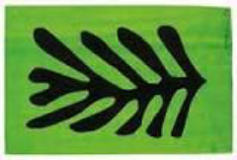
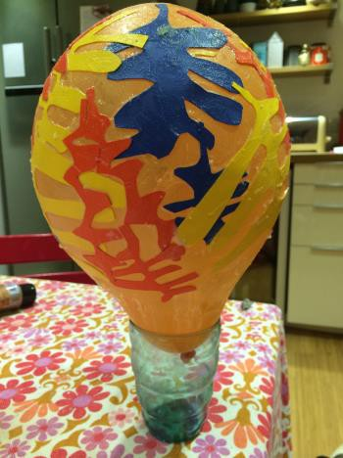
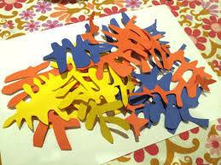
Creating your Matisse Egg
◆ The students should begin be cutting about 20-30 Matisse shaped leaves out of the cardstock (about 2 per page but you can make a selection of large and small leaves and fit 3 or 4 per page). Look at the Parakeet and Mermaid or the Black Leaf on Black Background as examples of the shapes the students should be creating.
◆ Once a student has a sufficient number of leaves, he/she should blow up the balloon and use a bowl as a stand for the balloon to hold it in place.

Slide 12
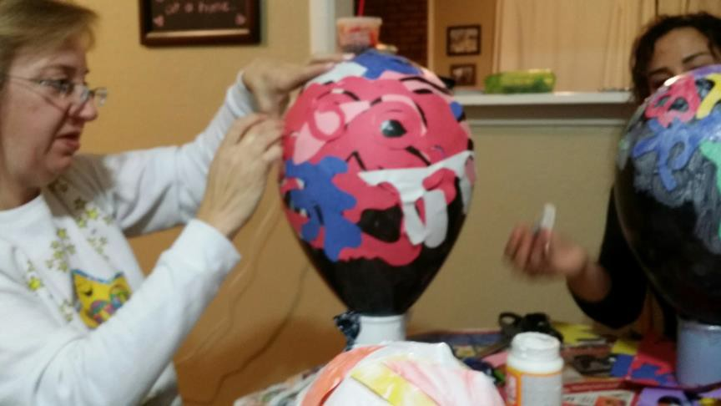
Creating Your Matisse Egg (2)
◆ The student should begin by writing their name on the first card stock leaf. Place the card stock leaf on the balloon and paint over the entire surface of the leaf using the mod podge so that it sticks to the balloon. Then continue adding the other leaves and covering with a thick layer of mod podge. They should vary the colors and ensure that the fronds of each leaf overlap one another so that they are all connected.
◆ Leave an opening at the bottom of the balloon where it is tied. If you cover the entire balloon, it will cause the egg to be misshaped when it is dry.

Slide 13
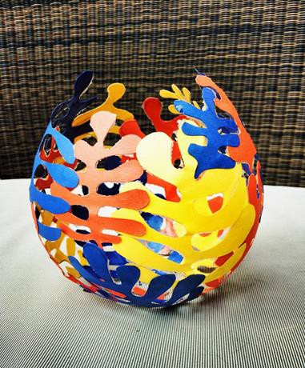
Creating Your Matisse Egg (3)
◆ Once the entire balloon is covered with the mod-podged leaves, it will be left to dry overnight.
◆ The next day, the balloons can be popped and the paper leaves should be dried in the egg shape. Pop the balloons over a garbage can as the mod podge can shatter and make a mess.
◆ Have a happy Matisse Easter!

