Slide 1
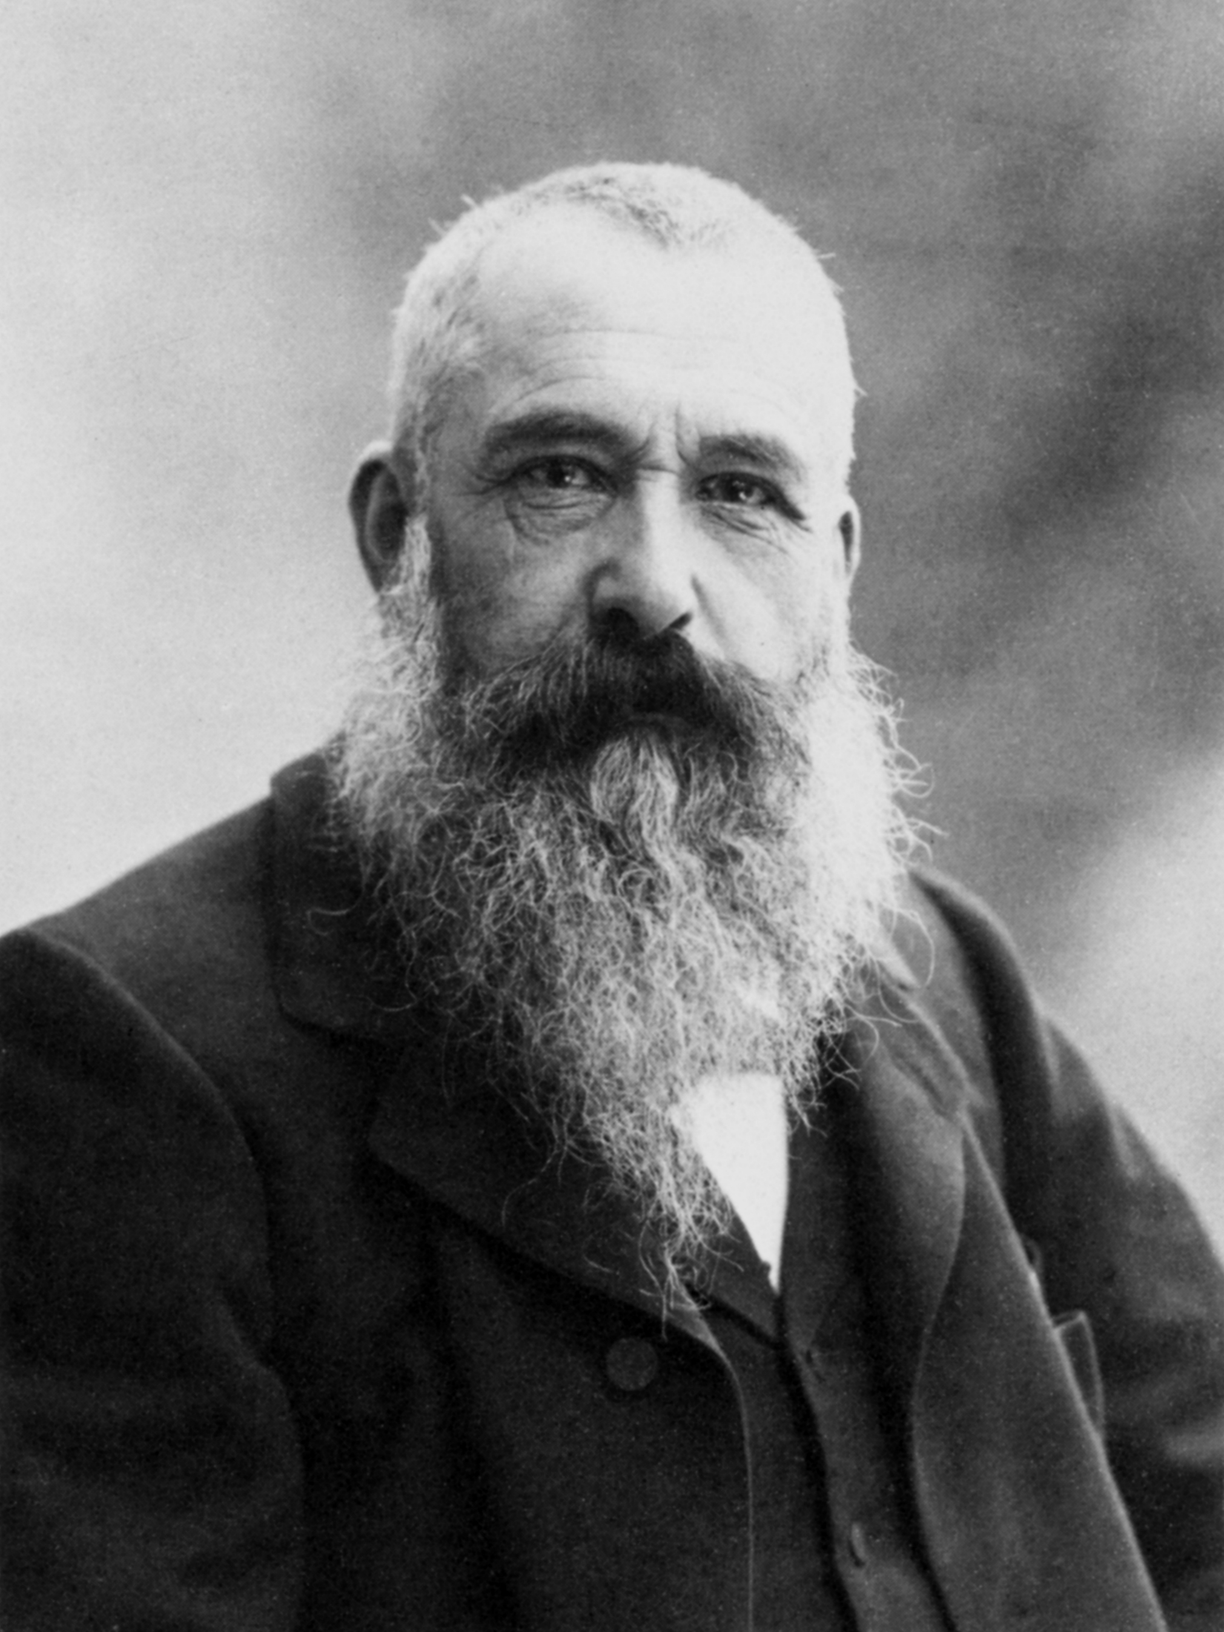
Claude Monet Born: November 1840 Died: December 1926 A Founder of French Impressionism
One of the founders of the Impressionist Movement

Slide 2
French Impressionist Movement
Art movement or philosophy that began in Paris in the mid 1800’s that was very different in style and subject from earlier art and new photography.
Painting was done “en plein air” or outside.
Depicted everyday people doing everyday things.
A study of light – same subject in different light/time/seasons.
Main subject was not centered – focus was on the scene.
Painting was done quickly with a flat brush, leaving short thick strokes and creating an impression of the scene, which was clearest from a distance.

Slide 3
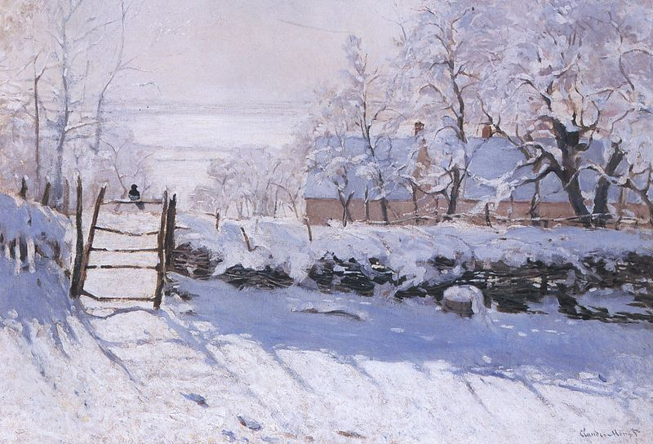

Slide 7
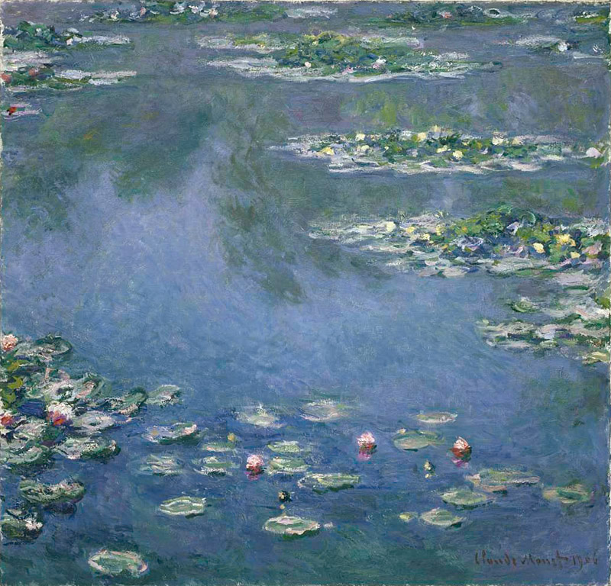

Slide 8
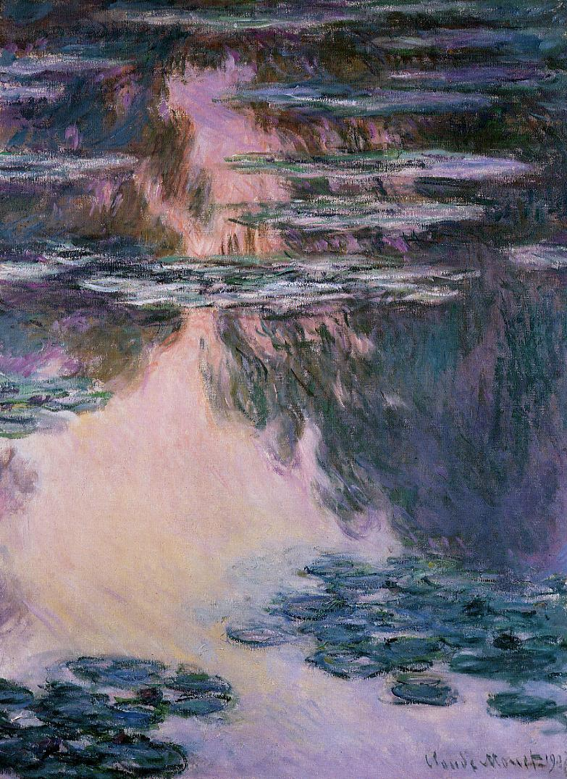

Slide 9
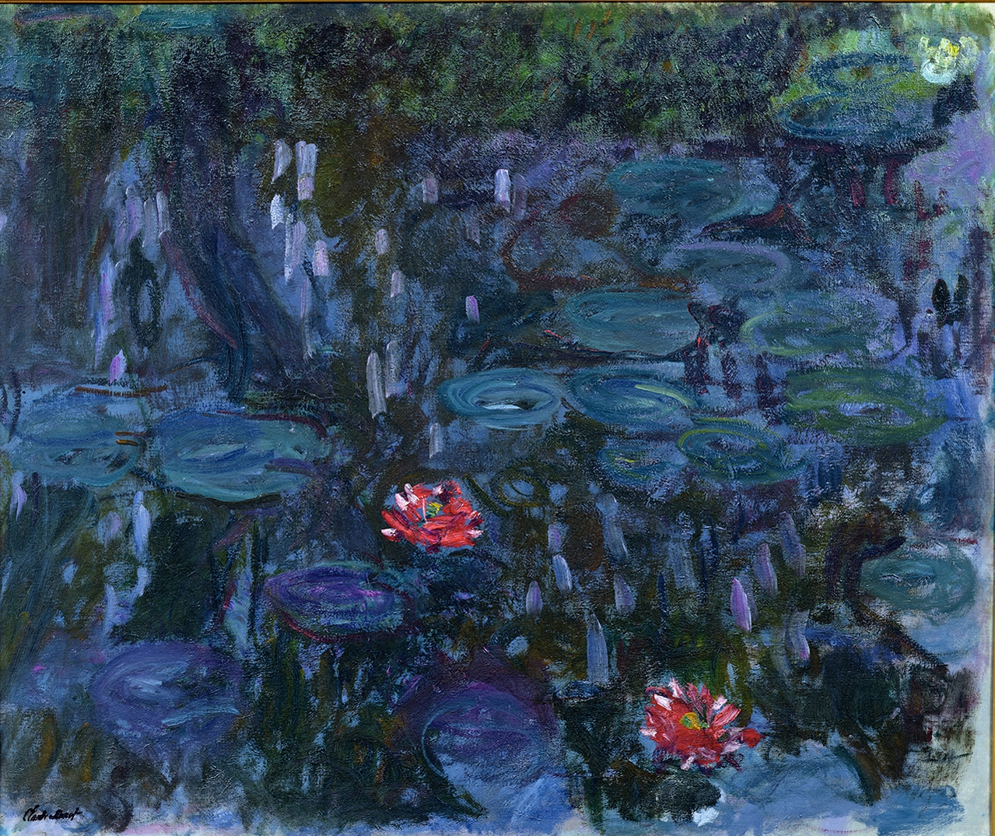

Slide 10
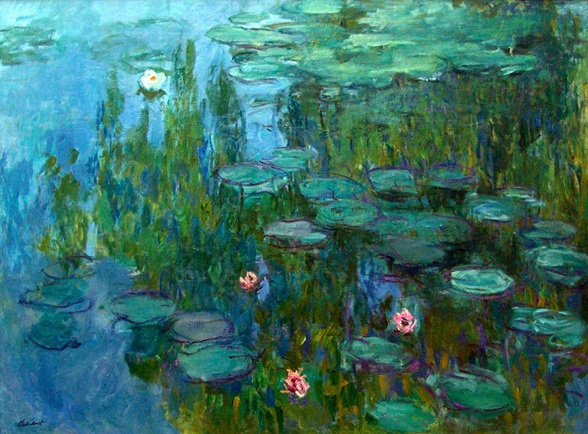

Slide 11
- How to Paint Like Monet -
http://www.youtube.com/watch?v=-Ftb1mkN30g

Slide 12
- Painting Your Own Water Lilies -
Decide on the light you want.
Do you want bright daylight or dusk or dawn.
Paint the water first.
Don’t overmix your colors.
Use short, horizontal strokes.
Add the reflection.
Use short, vertical strokes.
Paint lily pads then the flowers.

