Slide 1
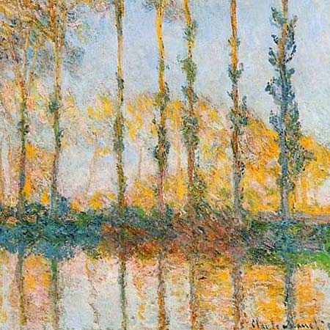
Trees, Monet and Texture
In Touch with Art
October 2013

Slide 2
In Touch with Art
Who loves art?
Students, teachers, parents, friends, everyone!
First, we’ll learn about a topic, an artist and their work
Then, we’ll create our own art work
Parents are here to help you

Slide 3
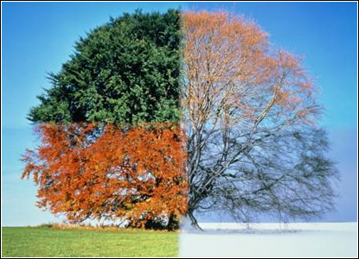
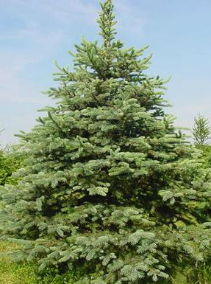
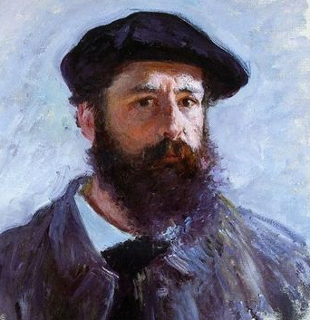
Let’s discuss 3 things
TREES
Changes across seasons…
or maybe not
Claude Monet
TEXTURE

Slide 4
Trees across the seasons
Winter
Spring
Summer
Fall
DECIDUOUS – LEAVES FALLING OFF
EVERGREEN
Notes:
This page shows two different types of trees during the 4 seasons of the year.
First, let’s talk about the seasons.
There are 4 seasons in a year – Winter, Spring, Summer, Fall (Point to the green boxes)
Ask questions to students (suggestions below):
What weather is during (winter, spring, summer, fall)?
Is it warm or cold?
How do you dress?
Have you seen snow?
What activities do you like to do?
Let’s take a closer look at trees in each of the 4 seasons.
On top row, I have one tree during each season and another type of tree on the bottom.
What do you notice about the trees?
How are they same? Different?
On the top row, they are called “Deciduous” trees, which means that leaves fall off.
Let’s say de-ci-duous together.
On the bottom row, these are “Evergreen” trees, staying green all year round.
Do you have a favorite type of tree? Or season?
Now, let’s read a book about an apple tree and see if it’s a deciduous or evergreen tree.

Slide 5
Claude Monet (1840 – 1926)
A Founder of French Impressionism
Painting was done outside –
rain or shine!
A study of light – same subject in different light, time and seasons.
Created an impression of the scene, which was clearest from a distance.

Slide 6
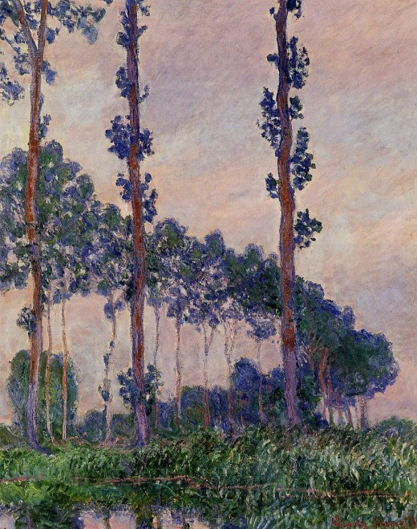
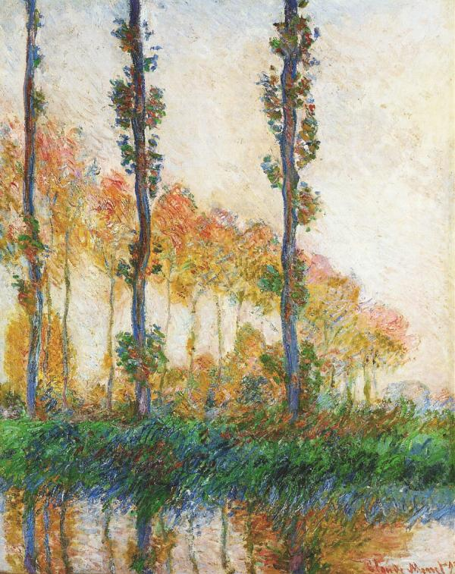
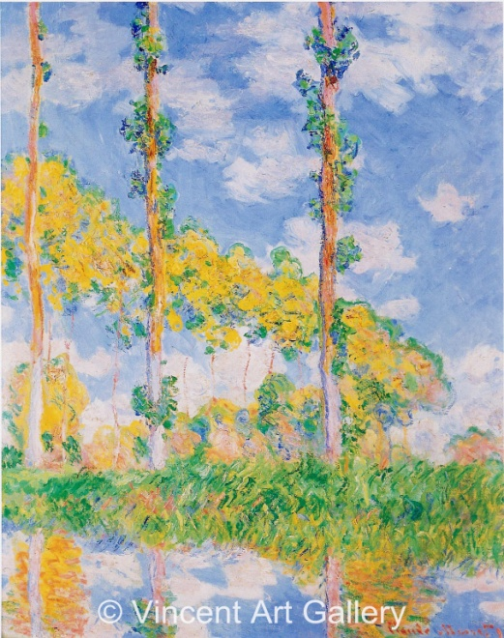
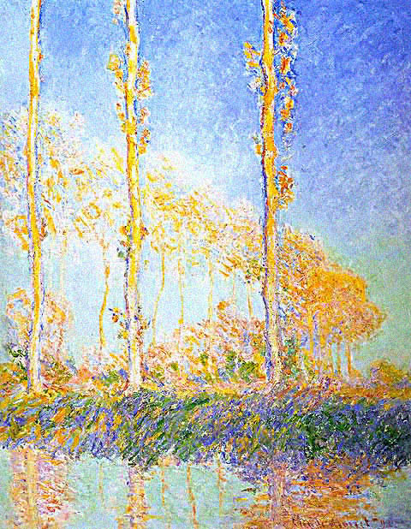
Three Trees (1891)
Winter
Spring
Summer
Fall
Notes:
He looked at the same trees, over the 4 seasons
Notice the difference in color of leaves and the sky?
Used different brush strokes, creating different texture…..next slide

Slide 7
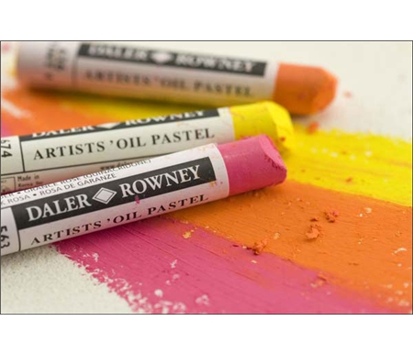
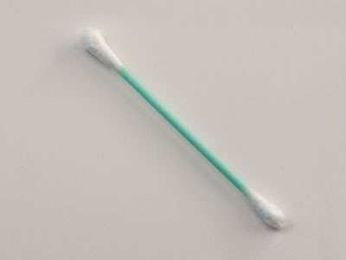
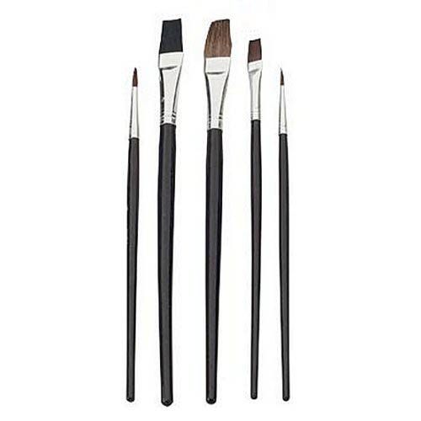
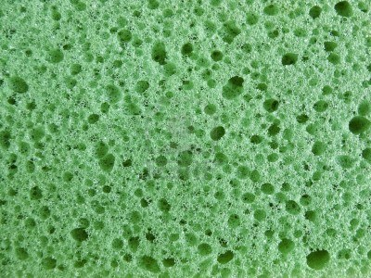
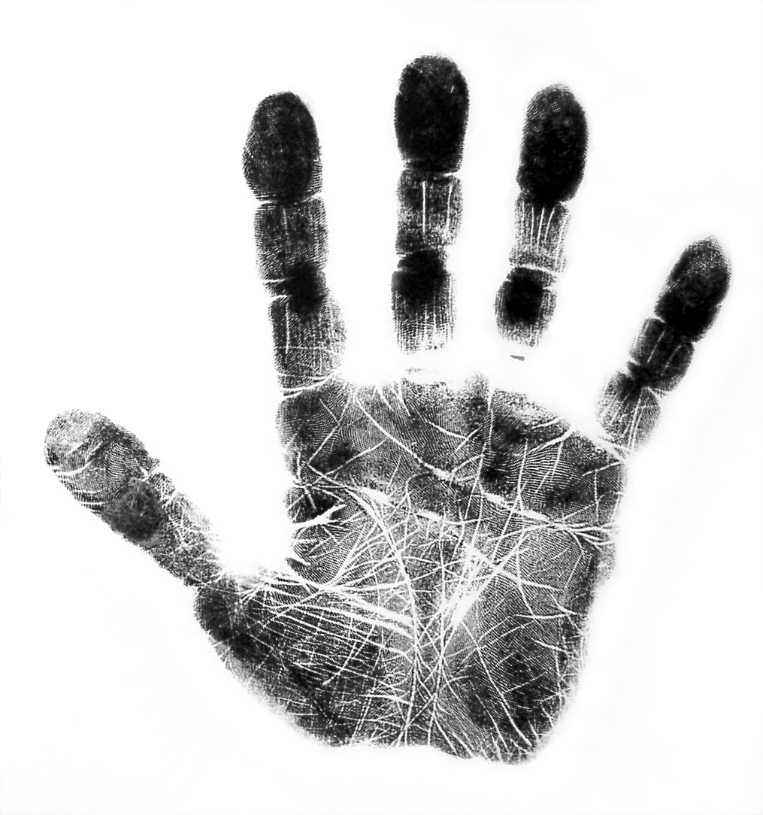
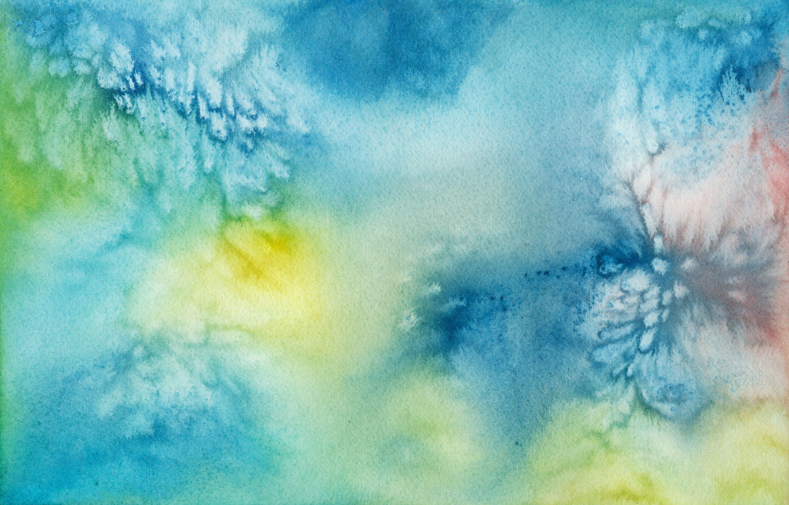
What’s TEXTURE?
p.6
Notes:
Texture – Look and/or feel
For example, a table is – smooth.
What about these pictures? What is the texture? How do they look or feel?
You can use different materials to create texture

Slide 8
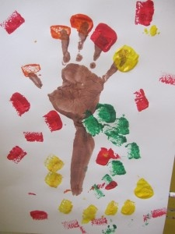
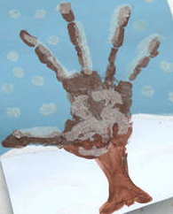
Art Project
CHOOSE DECIDUOUS:
FALL: Use sponge with fall colors
WINTER: Use Q-tip with white paint to dot the tree with snow
STAMP FIRST: Stamp your hand and arm to create the branch on one side of the paper. If you’re WINTER, put a blue piece of paper on one side, so you’ll be able to see the white snow
DRY handprint
GLUE EVERGREEN: glue a green tree top on top of a brown stump
PAINT TREE: Finish painting the deciduous tree
FALL: Sponge with paint. WINTER: Q-tip with white paint.

Slide 9
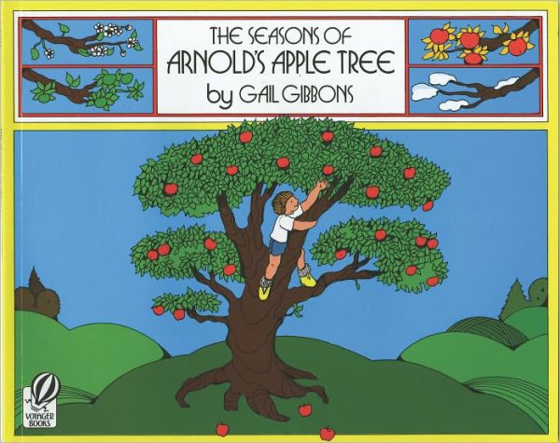
The Seasons of Arnold's Apple Tree

